Slide 1

Housekeeper Scheduling System

Slide 2

Group No: 5
Team Lead:- Deepak Kumar Bindhani
Group Members:-
Balaji Rajendra Davale
Deepsa Sahu
Dhanuja Bankapur
Ipsita Mishra
Huduguru Sreenath
Praveen Kumar Naidu Korrapati
Monika B V
GROUP 5

Slide 3
CONTENTS:-
Abstract
Objective
Project Architecture
Tools & Technologies Used
HTML & CSS
Angular
MySQL
Modules
User Module
Class Diagram
ER Diagram
Screenshots
Conclusion

Slide 4
Abstract :
The main objective of HOUSEKEEPER SHEDULING SYSTEM is hostel students can use to get their rooms cleaned on time.
Admin will select a housekeeper and allots a housekeeper with a specific request coming from a student
Using this HOUSEKEEPER SHEDULING SYSTEM Admin can Add, Edit and Delete housekeeper details like name, hostel, floor, rooms_cleaned and complaints. Also, Enable or disable the housekeeper.
By using HOUSEKEEPER SHEDULING SYSTEM we can maintain the feedback and request status of the user.

Slide 5
Objective:
The function will automatically generate cleaning plans based on the number of rooms, number of staff and amount of time spent cleaning per room
The housekeeping department takes pride in keeping the hotel clean and comfortable so as to create a ‗home away from home'. Good housekeeping is considered as the backbone of accommodation sector as its main aim is to provide a clean comfortable, safe and aesthetically appealing environment.

Slide 6
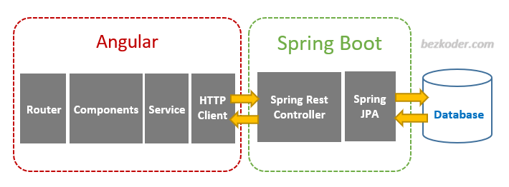
Project Architecture

Slide 7
Tools & Technologies Used
Front-End : Angular
Server-side : Spring Boot
Back-end : MYSQL, Hibernate
Server : Tomcat

Slide 8
HTML & CSS :
HTML (the Hypertext Markup Language) and CSS (Cascading Style Sheets) are two of the core technologies for building Web pages.
HTML is used to define a structure of a web pages, where as CSS is used to style the web pages by using different styling features.
Along with graphics and scripting, HTML and CSS are the basis of building Web pages and Web Applications.
HTML is the language for describing the structure of Web documents and CSS is the language for describing the presentation of Web pages, including colors, layout, and fonts etc..

Slide 9
Angular :-
Angular is a platform and framework for building single-page client (SPA) applications using HTML and TypeScript.
Angular is primary written in TypeScript. It implements core and optional functionality as a set of TypeScript libraries that you import into your applications.
Angular follows the modular design. We can create Angular modules to better organize and manage our codebase.
The architecture of an Angular application relies on certain fundamental concepts. The basic building blocks of the Angular framework are Angular components that are organized into NgModules.

Slide 10
MySQL:-
MySQL is currently the most popular database management system used for developing web based software applications.
It is open-source database software, which is supported by Oracle Corporation.
It is fast, scalable, and easy to use database management system in comparison with Microsoft SQL Server and Oracle Database.
MySQL handles large databases and also works on many platforms.
MySQL follows the working of Client-Server Architecture. This model is designed for the end-users called clients to access the resources from a central computer known as a server using network services.

Slide 11
Modules:
The system comprises of 2 major modules with their sub-modules as follows:
Admin:
Login: Admin can login his personal account.
Dashboard: Where all the details are displayed.
Allot: Admin can allot a housekeeper.
Complaints: Complaints which are raised by the user are displayed.
Suggestions: Suggestions which are given by the user are displayed.
Register Student: Admin can register a new student.
Register Housekeeper: Admin can register a new housekeeper.
Logout: Admin can logout after the completion of his work

Slide 12
User Module:
Login: User can login his personal account.
Dashboard: Where all the details are displayed.
Requests: User can request a housekeeper by selecting date and time.
Feedback: User gives the feedback like suggestions and complaints about the housekeeper performance.
Profile: Details of the User.
Logout: User can logout after the completion of his work.

Slide 13
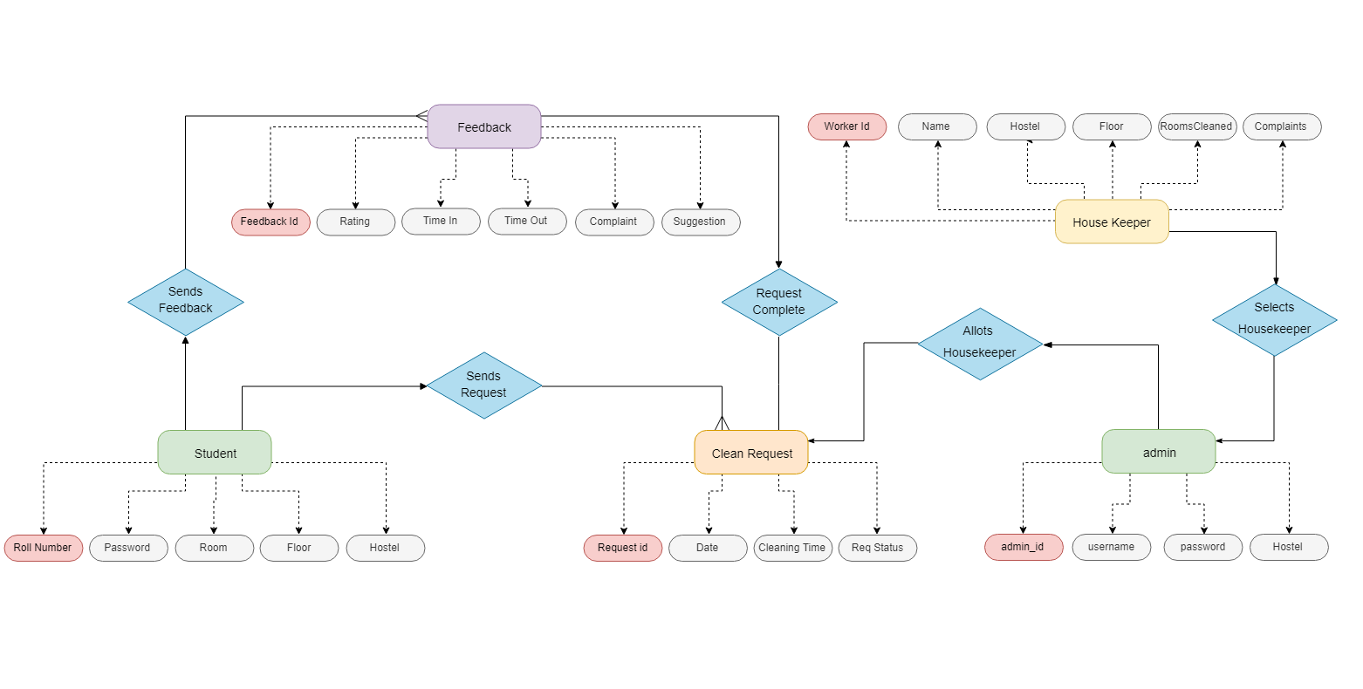
Class Diagram:-

Slide 14
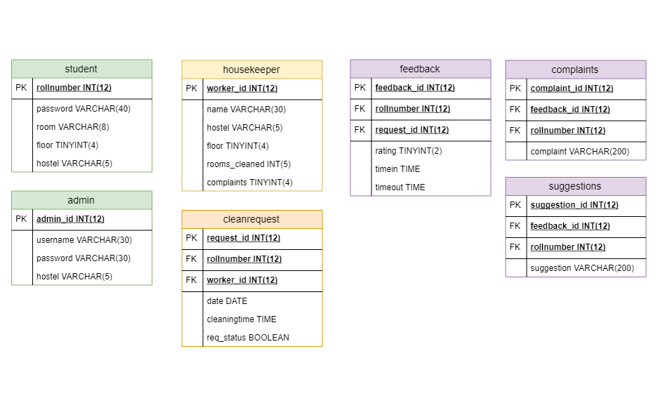
ER Diagram:-

Slide 15
Advantages:-
This system is very easy to understand and user friendly.
Student and Hostel Warden are connected with each other on one system.
This system is saving the time for student and hostel warden too.
In this system user can connect any time whenever he/she wants.
This system is secure.

Slide 16
Disadvantages:-
Privacy issues
One Vendor Dependency
Not for Individual as it will be costly
Technology Dependency

Slide 17
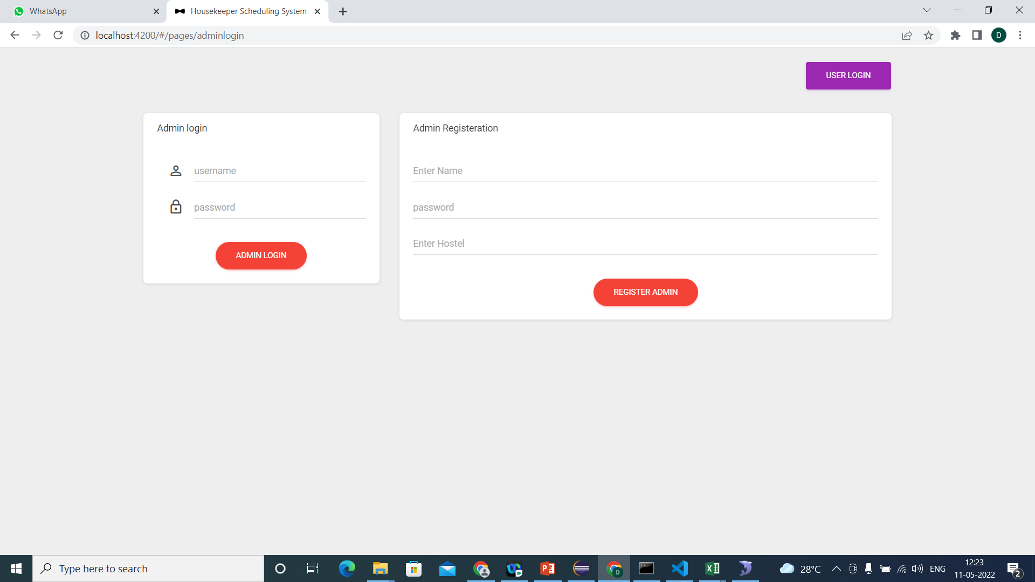
Screenshots:(Login page:)

Slide 18
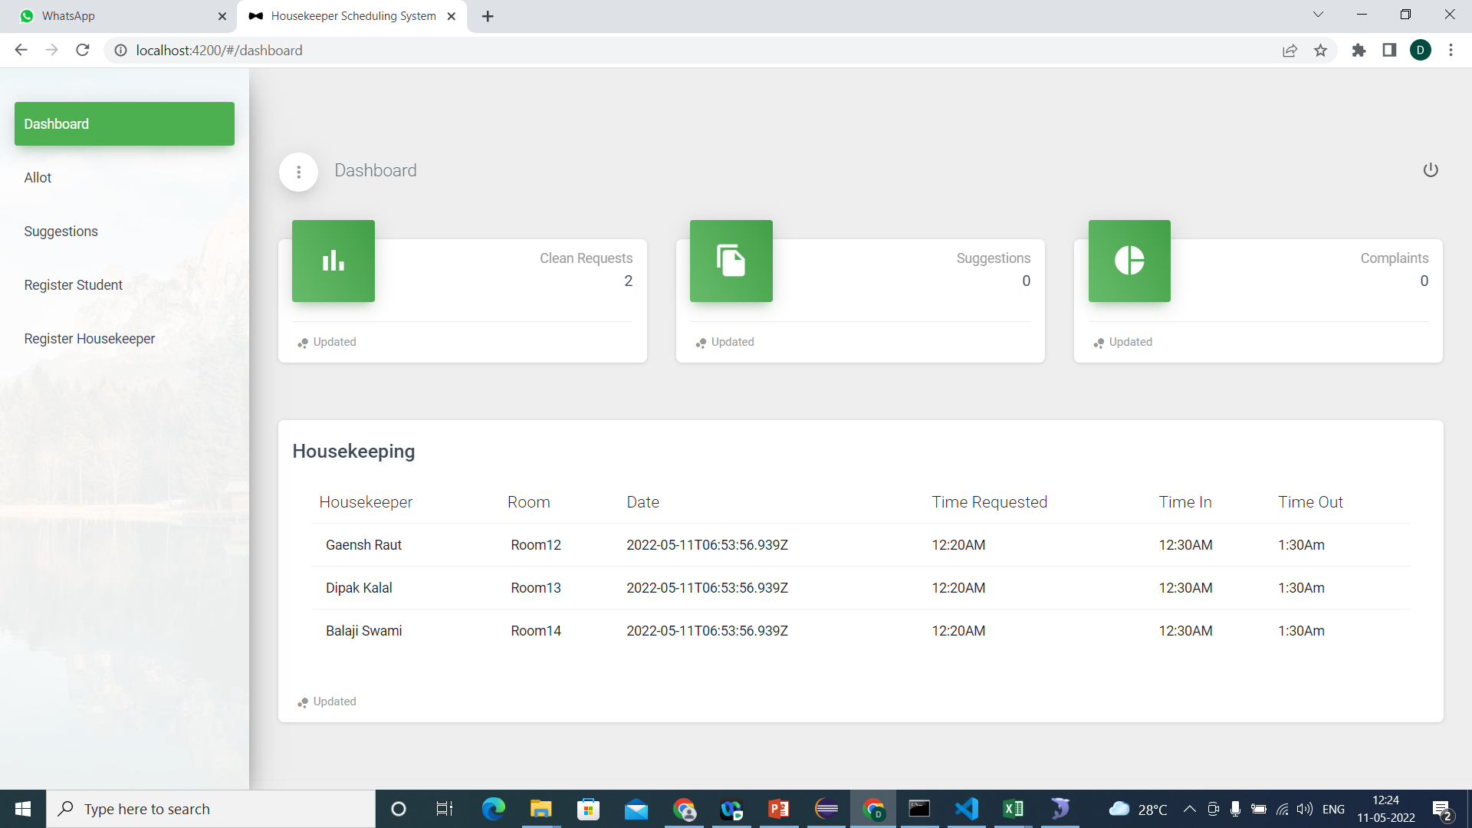
Admin Dashboard:-

Slide 19
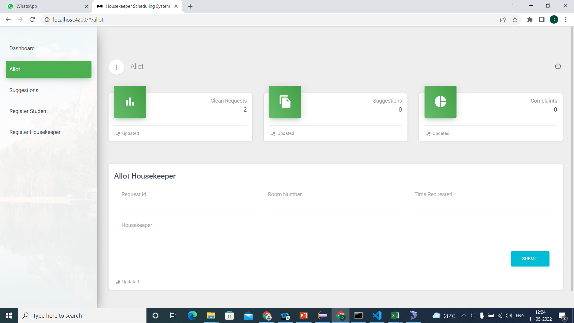
Allot Housekeeper:-

Slide 20
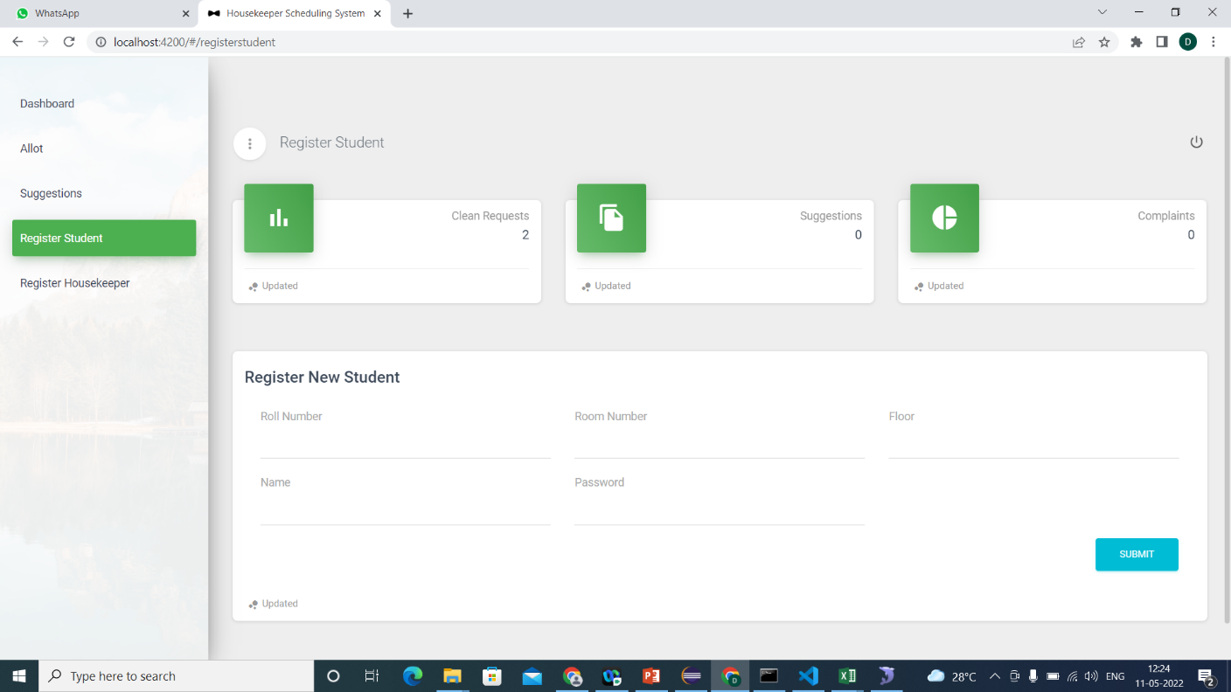
Register Student:-

Slide 21
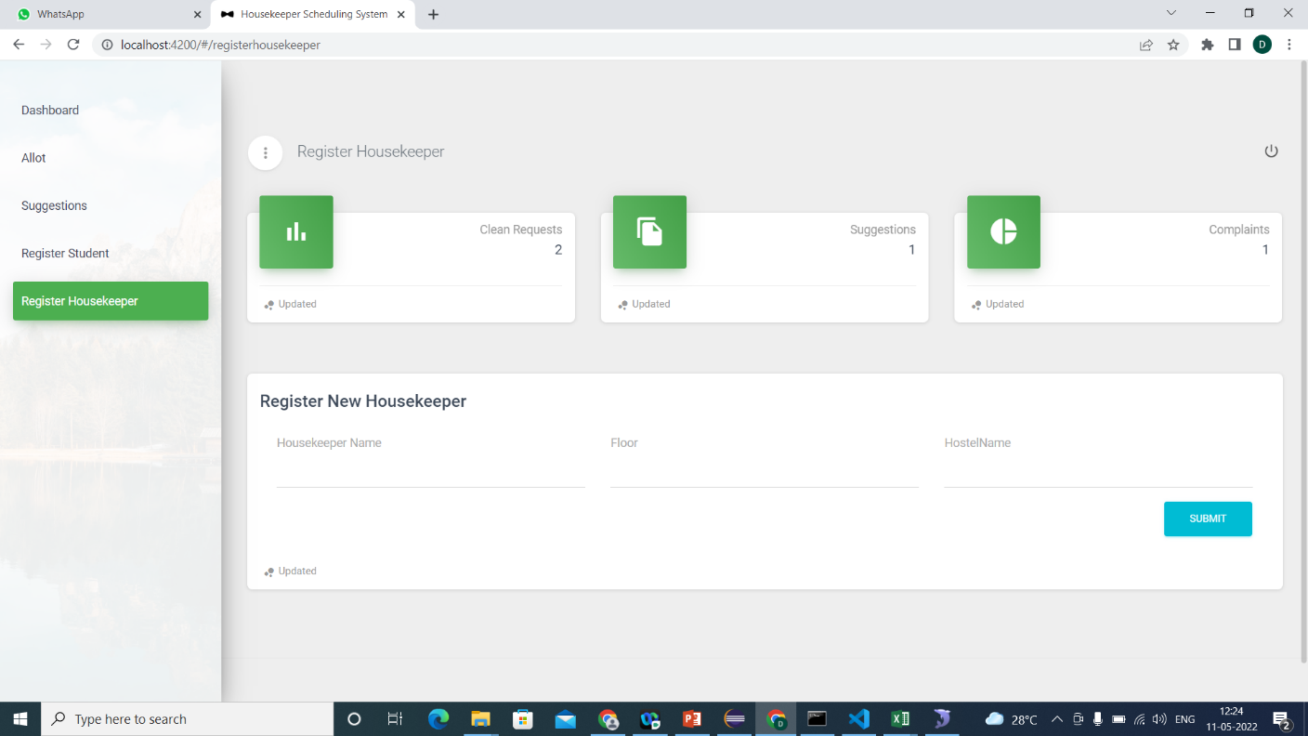
Register Housekeeper:-

Slide 22
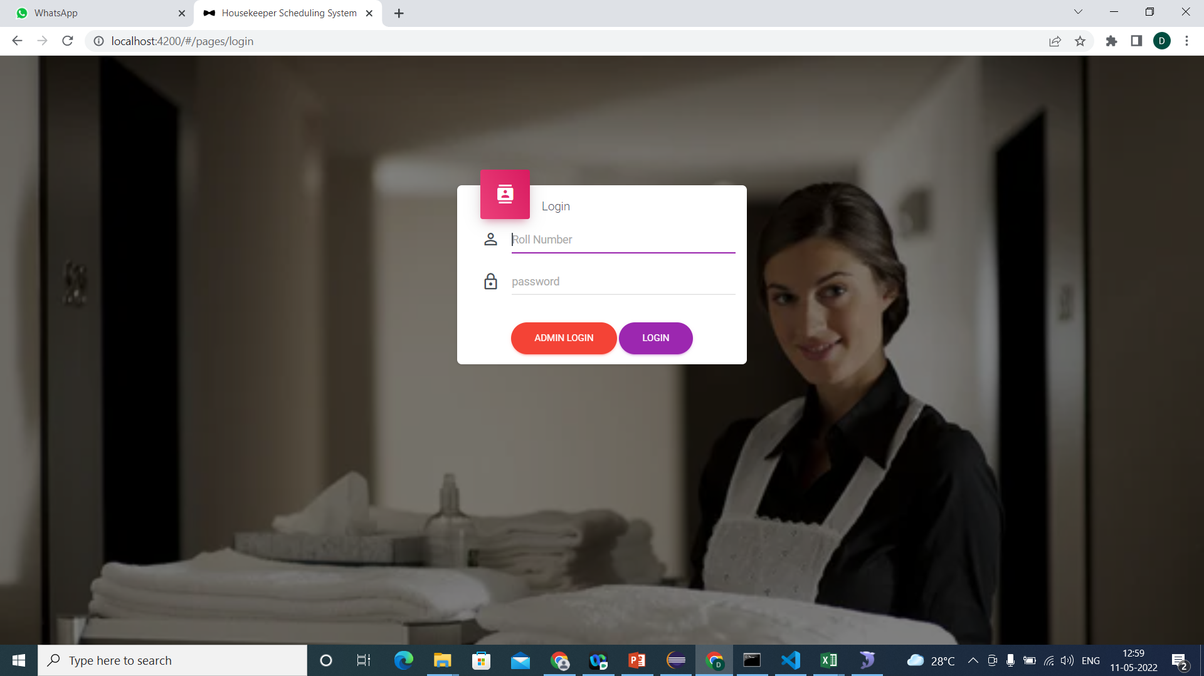
User Login:-

Slide 23
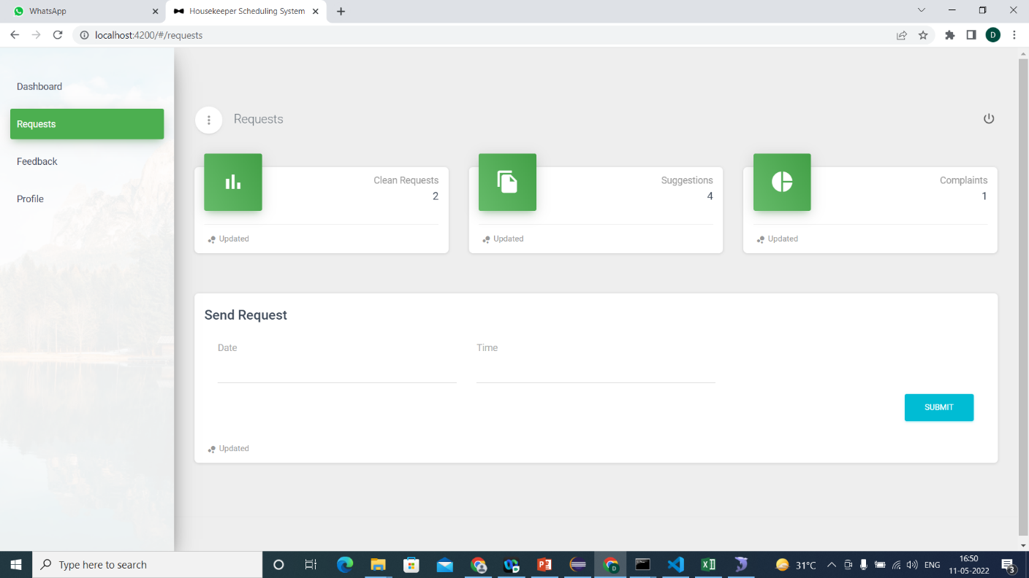
User Request:-

Slide 24
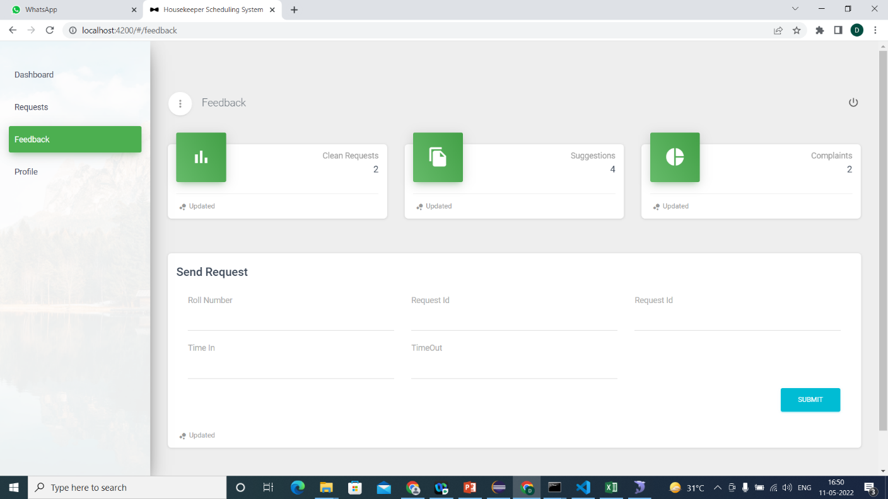
User Feedback:-

Slide 25
Conclusion:-
The Housekeeper Scheduling System Application Student send clean request to admin in admin side automatically create a cleaning schedule.
Each day for each housekeeper based on the number of student send clean request, And each rooms, estimated clean time per room, and number of housekeepers.
This system develops a new trends serves to meet user expectations, enhance service delivery and improve efficiency .

Slide 26


